Slide 1
Data Types, Errors and Debugging, Advanced Math Operations & Formatting Output
CSCI-UA.0002
Introduction to Computer Programming

Slide 2
Data Types

Slide 3
Data Types in Python
Variables in a programming language consist of three components:
An identifier (i.e the variable name)
A value (i.e. the item being stored)
A data type (i.e. what kind of data is being stored)
Python needs to know how to set aside memory in your computer based on what kind of information you want to store
There are three basic types of data that we will be working with during the first half of the term
Strings (character-based data)
Numbers
Logical Values (True / False)

Slide 4
Numeric Data Types
Integers
Whole numbers that do not contain a decimal point
Abbreviated as "int" in Python
Example: 5, -5, 100, 10032
Floating Point Numbers
Numbers that contain a decimal point
Abbreviated as "float" in Python
Example: 5.0, -5.0, 100.99, 0.232132234

Slide 5
Storing Numeric Values
You can store numeric data inside variables that you create. Example: num_1 = 5 # this is an int num_2 = 4.99 # this is a float
Keep in mind that you do not use separators or symbols when storing numeric data. Example: num_3 = $5,123.99 # error!

Slide 6
What's the data type?
5
5.5
"Hello"
"5.5"
2.975
2.0

Slide 7
Strongly Typed Languages
Python is not a strongly typed language.
This means that you don't need to pre-declare what kind of data your variables will be holding, unlike other languages such as Java.

Slide 8
Data Types across languages
Loosely Typed
Strongly Typed
Python
PHP
JavaScript
Perl
C
C++
Java
C#

Slide 9
Creating Variables in a Strongly Typed Language (Java)
String name = "Pikachu";
int top_speed = 50;
float gravity = 9.5;

Slide 10
Performing Calculations

Slide 11
Performing Calculations in Python
Algorithms generally require some kind of calculation to be performed
All programming languages have tools for manipulating numeric data – we generally call these "math operations"

Slide 12
Python Math Operations
Operation
Operator
Addition
Subtraction
Multiplication
Division (floating point)
Division (integer)
+
-
*
/
//

Slide 13
Expressions
We use operators along with numeric data to create "math expressions" that Python can "evaluate" on our behalf

Slide 14
Constructing Math Expressions
5 + 2
7 – 6
2 * 3
6 / 2
6 + 2 - 12
operator
operand
operand

Slide 15
Outputting math expressions
print(5+2)
print(100 * 5 – 12)

Slide 16
Storing the results of an expression
answer = 5 + 2
print('the answer to 5 + 2 is', answer)

Slide 17
Using variables in math expressions
Math expressions don't necessarily need to involve only numeric literals
Example: price = 100.00 sales_tax = 0.07 total = price + sales_tax*price

Slide 18
String Concatenation
You can't "add" strings together, but you can "concatenate" them into a single compound string
Example: a = input('first name') b = input('last name') c = b + ',' + a print(c)

Slide 19
String Repetition
You can also "multiply" a string by an integer value to produce a larger string
Example: lyrics = 'Fa ' + 'La ' * 8 print(lyrics) # Fa La La La La La La La La

Slide 20
Division Operations
Python contains two different division operators
The "/" operator is used to calculate the floating-point result of a division operation
The "//" operator is used to calculate the integer result of a division operation (essentially throwing away the remainder). This operation will always round down.
Most times you will use the floating point division operator ("/")

Slide 21
Division Expression Evaluation
print(5/2)
print(5//2)
print(-5/2)
print(-5//2)
# 2.5
# 2
# -2.5
# -3

Slide 22
Mixed Type Expressions
Python allows you to mix the numeric data types (ints and floats) when performing calculations.
The result of a mixed-type expression will evaluate based on the operands used in the expression

Slide 23
Mixed Type Expressions Matrix
Operand 1 | Operand 2 | Result
int | int | int
int | float | float
int | string | ERROR
float | int | float
float | float | float
float | string | ERROR
string | int | ERROR
string | float | ERROR
string | string | string

Slide 24
Poll Everywhere Check-in

Slide 25
User input and Math Expressions
We can capture input from the user (via the input() function) and use that input in our calculations
However, the input() function "returns" a string – this means that the data type that "comes out" of the input() function is a series of printed characters
We need to convert the result of the input function from a string into one of the two numeric data types that Python supports (float and int)

Slide 26
Solution: The float() and int() functions
float() and int() are data type conversion functions. They each take one argument and convert that argument into the specified data type
Example: # ask the user for their monthly salary monthly_salary = input('how much do you make in a month?') # convert the salary into a float monthly_salary_float = float(monthly_salary) # calculate the yearly salary yearly_salary = monthly_salary_float * 12 # print the result print('that means you make', yearly_salary, 'in a year')

Slide 27
Nested data type conversions
In the previous example we performed our data type conversion in two lines
We could have done that in a single line using a technique called "nesting"
Example: mynum = float( input('give me a number!') )

Slide 28
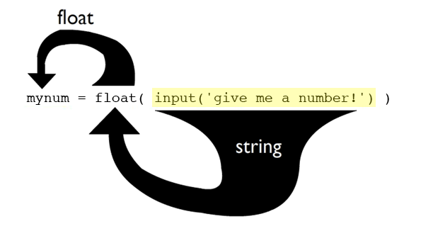
Nested Function Flow of Execution

Slide 29
Programming Challenge: Average Calculator
Write a program that asks the user for their name
Next, ask the user for 3 test scores
Compute the average test score and print it back to the user. For example: Enter your name: Pikachu Test 1: 100 Test 2: 90 Test 3: 80 Thanks Pikachu! Your average score is: 90.0

Slide 30
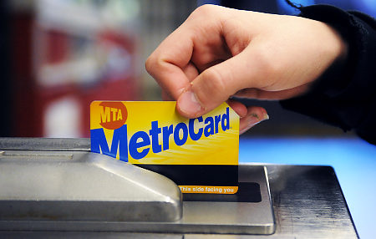
Programming Challenge – Subway Ride Calculator
Write a program that asks the user for the value of their current Metro card
Compute how many rides they have left on their card. Only provide whole number results (i.e. you cannot have 3.5 rides left on a card)

Slide 31
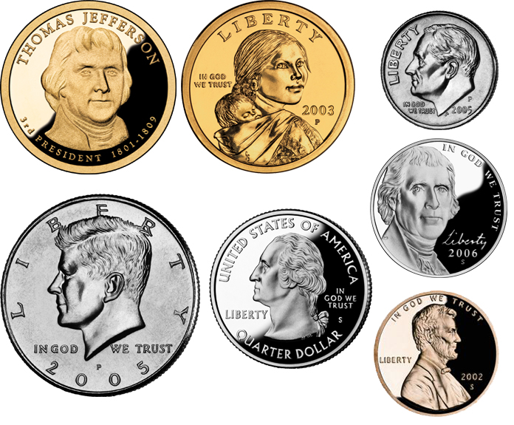
Programming Challenge - Coins
Write a program that asks the user for a number of pennies, nickels, dimes and quarters
Calculate the total amount of money that the user has and print it out

Slide 32
Why does this happen?
Just for fun, try executing this code: x = 0.1 + 0.2 print(x)
One would expect the answer to be 0.3, right? But when you run the code above you actually get some very strange output: 0.30000000000000004

Slide 33
Floating Point Inaccuracies
The issue here is that not all fractional numbers can be represented in the base 2 number system. This actually isn't anything you haven't seen before – for example, compute the answer to this expression in your head: 1/3
The resulting answer is repeating decimal number (0.333333 ). In order to represent this value we would need an infinite # of digits.
The same issue occurs in binary, which is why Python sometimes yields odd results for floating point expressions. A rounding error often gets introduced.

Slide 34
Algorithm for Converting from Decimal to Binary
0.1 is a repeating decimal point number in binary: 0.1D = 0.00011001100110011001100110011 … B
The process of converting from decimal fraction to a binary fraction is as follows:
Multiply the # by 2
If there is a 0 to the LEFT of the decimal point, write down a 0
If there is a 1 to the LEFT of the decimal point, write down a 1
Throw away the number to the left of the decimal point
Repeat the process until the number is 0.0

Slide 35
Sample Conversion from Decimal to Binary
0.1 x 2 = 0.2
0.2 x 2 = 0.4
0.4 x 2 = 0.8
0.8 x 2 = 1.6
0.6 x 2 = 1.2
0.2 x 2 = 0.4
0.4 x 2 = 0.8
0.8 x 2 = 1.6
0.6 x 2 = 1.2
.0
.00
.000
.0001
.00011
.000110
.0001100
.00011001
.000110011

Slide 36
Errors, Bugs and Debugging

Slide 37
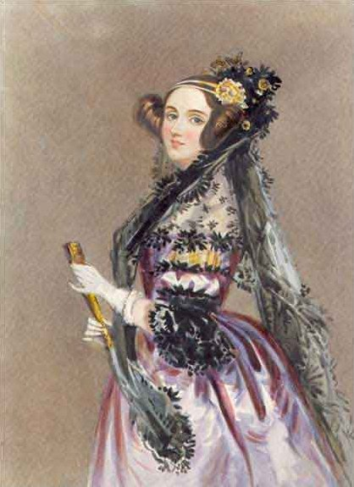
The Software Error
"...an analyzing process must equally have been performed in order to furnish the Analytical Engine with the necessary operative data; and that herein may also lie a possible source of error. Granted that the actual mechanism is unerring in its processes, the cards may give it wrong orders."
- Lady Augusta Ada King, Countess of Lovelace (1843)

Slide 38
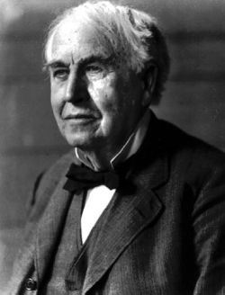
Mechanical Malfunctions
"It has been just so in all of my inventions. The first step is an intuition, and comes with a burst, then difficulties arise—this thing gives out and [it is] then that 'Bugs' — as such little faults and difficulties are called—show themselves and months of intense watching, study and labor are requisite before commercial success or failure is certainly reached."
- Thomas Edison, 1878

Slide 39
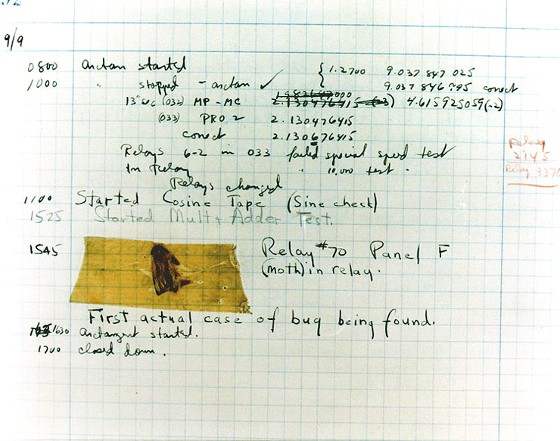
"Debugging"
1947, Harvard Mark II Computer

Slide 40
"Debugging" in Programming
Debugging a program is the process of finding and resolving errors.

Slide 41
Types of Errors
Syntax errors: The code does not follow the rules of the language; for example, a single quote is used where a double quote is needed; a colon is missing; a keyword is used as a variable name.
Runtime errors: In this case, your code is fine but the program does not run as expected (it "crashes"). For example, if your program is meant to divide two numbers, but does not test for a zero divisor, a run-time error would occur when the program attempts to divide by zero.
Logic errors: These can be the hardest to find. In this case, the program is correct from a syntax perspective; and it runs; but the result is unanticipated or outright wrong. For example, if your program prints "2+2 = 5" the answer is clearly wrong ☺

Slide 42
Example Error #1
print("hello, world!')

Slide 43
Example Error #1: Solution
print("hello, world!')
Syntax error (delimiters don't match)

Slide 44
Example Error #2
Source
Execution
num = input('give me a number: ')
num_float = float(num)
new_num = 10 + num_float
print(new_num)
give me a number: apple
Traceback (most recent call last):
File "/Users/username/Documents/madlibs01.py", line 6, in <module>
new_num = 10 + num
TypeError: unsupported operand type(s) for +: 'int' and 'str'

Slide 45
(that was a runtime error)
The program ran, but when given bad data it crashed

Slide 46
Example Error #3
Source
Execution
num_1 = float(input('Num1: '))
num_2 = float(input('Num2: '))
print('the sum is: ', num_1 – num_2)
Num1: 5
Num2: 2
the sum is: 3.0

Slide 47
(that was a logic error)
The program ran, but it didn't do what it set out to do (i.e. it gave us the wrong answer)

Slide 48
Basic Debugging Techniques
Set small, incremental goals for your program. Don't try and write large programs all at once.
Stop and test your work often as you go. Celebrate small successes ☺
Use comments to have Python ignore certain lines that are giving you trouble
Use the Python Tutor website (http://www.pythontutor.com/) to visualize how your programs are running and to inspect the values of all variables in memory

Slide 49
Asking for help
Clearly identify the issue you are experiencing
Describe when the issue happens
Does the issue happen all of the time?
Is it possible to avoid the issue if you supply different inputs?
Describe what you've tried to fix the problem so far.
Identify where you feel your program "breaks down"
Hypothesize as to why you think the breakdown occurred
Make sure you attach / show relevant source code files

Slide 50
Debugging Challenge
1 # My Awesome Program
2 # By Pikachu Pokemon
3
4 first_name = "Pikachu'
5 last_name = Pokemon
6
7 print("Welcome to the "Super Quiz" system", firstname, lastname, "!")
8 print()
9
10 answer = input(float("What is the answer to 5 + 2? ")
11 print("You answered:", answer)
12
13 print()
14
15 real_answer = 5 * 2
16
17 printt("If you answered", real_answer, "you're right!")

Slide 51
Math Operations Continued

Slide 52
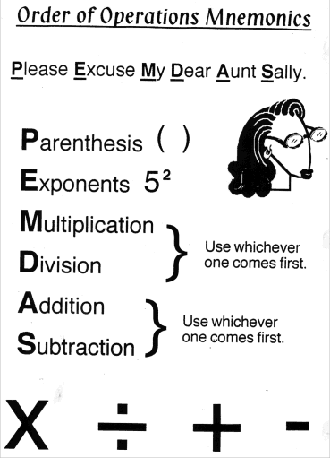
Order of Operations
Python supports the standard order of operations (PEMDAS)
You can use parenthetical notation inside your math expressions to group operations
Ex: ((5+10+20)/60) * 100

Slide 53
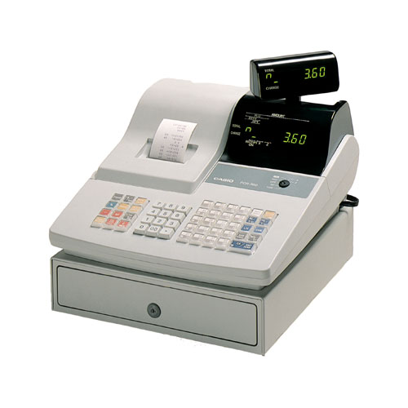
Programming Challenge: Adding Machine
Write a program that asks the user for three price values.
Calculate the average price in a single variable and output it to the user

Slide 54
Calculating an average in a single step
average_score = (100 + 50 + 88) / 300

Slide 55
Exponents
You can raise any number to a power by using the "**" operator
Example: 2⁴ 2 ** 4

Slide 56
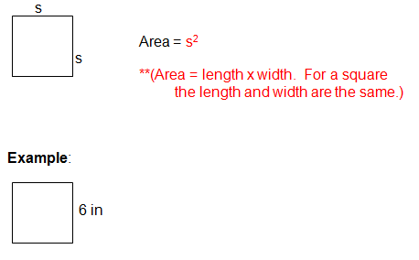
Programming Challenge: Calculating the area of a square

Slide 57
Remainder Operator (modulo)
The modulo operator ("%") returns the remainder portion of a division operation
Example: 5/2 # 2.5 5%2 # 1

Slide 58
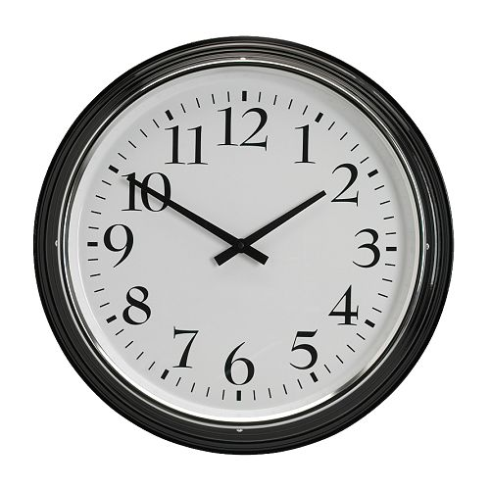
Programming Challenge: Time Calculations
Ask the user to input a number of seconds as a whole number.
Then express the time value inputted as a combination of minutes and seconds. Enter seconds: 110 That's 1 minute and 50 seconds

Slide 59
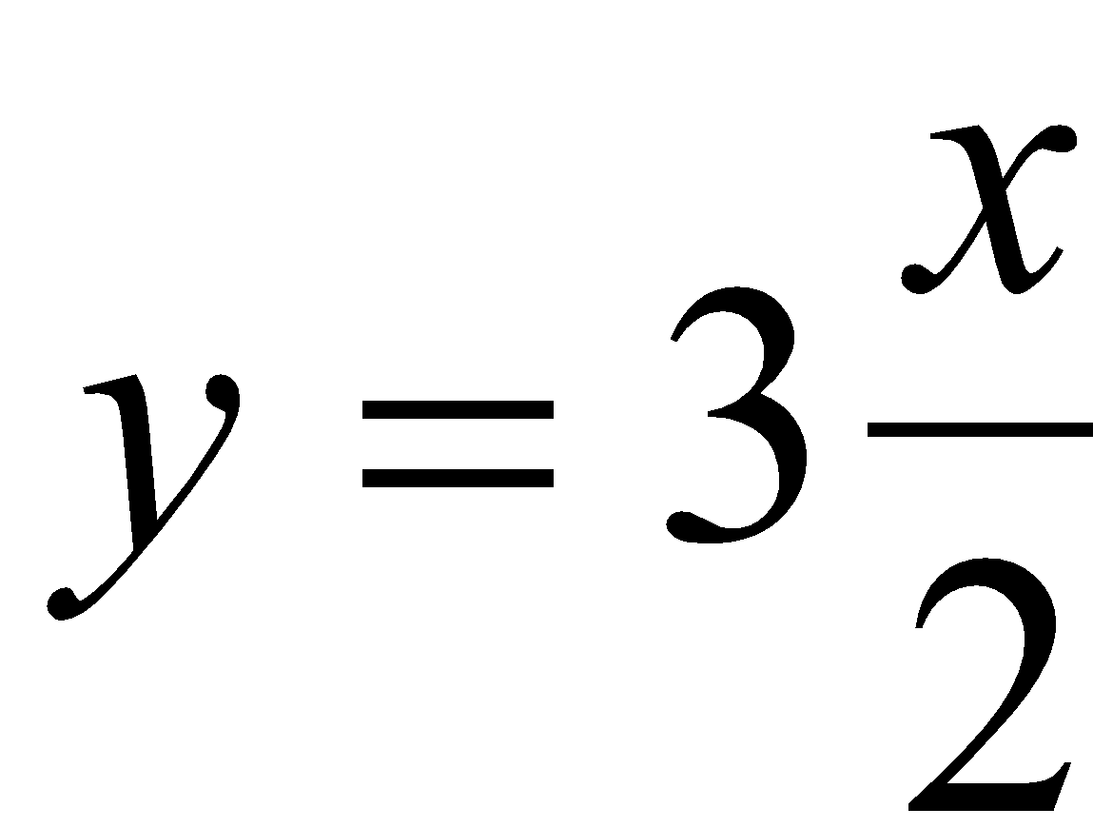
Converting Math Formulas into Programming Statements
10b
(3)(12)
4xy
10 * b
3 * 12
4 * x * y
y = 3 * x / 2

Slide 60
Line Continuation
Sometimes expressions can get to be very long
You can use the "\" symbol to indicate to Python that you'd like to continue the expression onto another line
Example: x = 5 + 2 / 7 \ + 8 – 12
This also works for print() function calls as well

Slide 61
The format() function

Slide 62
Formatting Strings
The format() function can be used to format a string before you decide to print it out to the user
format() takes two arguments – a number and a formatting pattern (expressed as a string)
format() returns a string which can be treated like any other string (i.e. you can print it out immediately, store its value in a variable, etc)

Slide 63
The Format function
The first argument passed to the format function is the item that you wish to format
The second argument passed to the function is the formatting "pattern" you wish to apply to this item
This pattern varies based on what you would like to do to the item in question
Once the pattern is applied to the item the format function will return a string version of your item with the formatting pattern applied

Slide 64
String Formatting
One common use of string formatting is to generate a string that contains a known # of characters
For example, say you have the strings "Python" and "Computer Science". You might want to generate output that looks like the following given these items: Name Department Python Computer Science
In this case we need to ensure that the strings "Name" and "Python" are the same width so that the strings that come after them ("Department" and "Computer Science") line up correctly.

Slide 65
The "format" function
You can use the format() function to "pad" a string with extra spaces at the beginning or the end of the string.
For example: x = format('Python', '<20s')
This will generate a new string (x) that contains the string 'Python' plus 14 spaces at the end of the string. The total length of the string in this case will be 20 characters.
The '<' character in the formatting pattern tells Python to left justify the string and place the extra spaces at the end of the new string

Slide 66
String Formatting: Justification
You can also have Python right justify the string and place the spaces at the beginning of the new string by doing the following: b = format('Pikachu', '>20s')

Slide 67
String Formatting: Justification Example
x = "Hello, World!"
y = format(x, '>20s')
print(x)
>> Hello, World!
print(y)
>> Hello, World!

Slide 68
Formatting Numbers
The format() function can also be used to generate a printable string version of a float or integer number
format() takes two arguments – a number and a formatting pattern (expressed as a string)
format() returns a string which can be treated like any other string (i.e. you can print it out immediately, store its value in a variable, etc)

Slide 69
Limiting decimal precision
a = 1/6
print(a)
b = format(a, '.2f')
print(b)
0.16666666666666666
0.17

Slide 70
Formatting patterns
a = 10000/6
b = format(a, '.2f')
c = format(a, '.5f')
d = format(a, ',.5f')
e = format(a, '>20,.2f')
# format a as a 2 digit float
# format a as a 5 digit float
# 5 digit float & comma separators
# 2 digit float, commas + 20
# character minimum field width
# justified to the right

Slide 71
Formatting Percentages
a = 0.52
print(format(a, '%'))
print(format(a, '.2%'))
print(format(a, '.0%'))
52.000000%
52.00%
52%

Slide 72
Formatting Integers
a = 20000
print(format(a, ',d'))
print(format(a, '>20,d'))
20,000
20,000

Slide 73
Programming Challenge: Tabular Layout
Write a program that generates the 2 times table, like this: Number1 Number2 N1 * N2 2 1 2 2 2 4 2 3 6 2 4 8

Slide 74
Python f-Strings
Newer versions of the Python language (version 3.6 and above) supports a new way to format variables & string literals.
This technique is called Literal String Interpolation, f-strings or “formatted” strings
The technique allows you to include a variable inside of a string literal using the following syntax: a = 5 b = 10 print(f"a is holding {a} and b is holding {b}") # output a is holding 5 and b is holding 10
Note how the string begins with the letter “f” outside of the delimiter – this tells Python that the string can include variables that are further delimited using curly braces

Slide 75
Python f-Strings with Formatting Patterns
Formatting patterns can also be used within "f-strings" to format output. For example: price = 12345.6789 print(f"The price is {price:,.2f}") # output The price is 12,345.68
The optional formatting pattern can be supplied inside of the {} delimiters, after a colon

